Slide 1
HAND GESTURE RECOGNITION

Slide 2
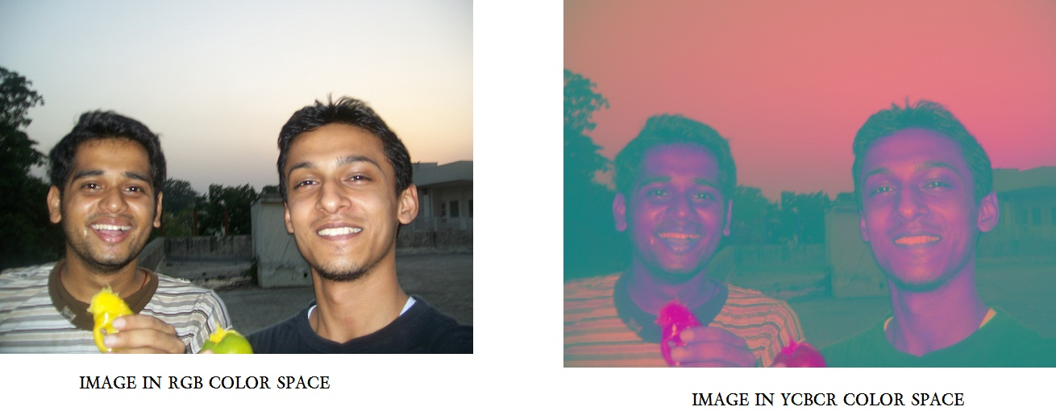
SKIN DETECTION

Slide 3
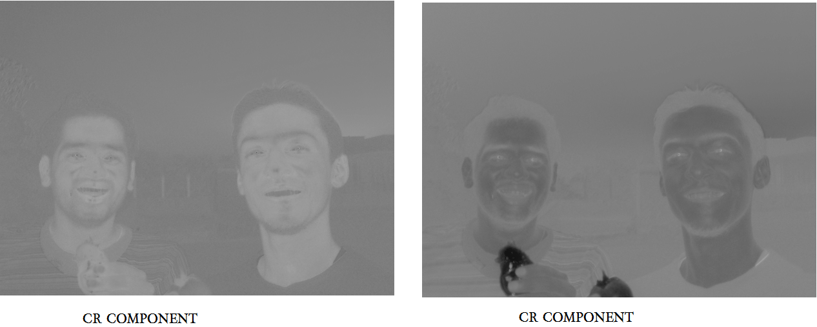

Slide 4
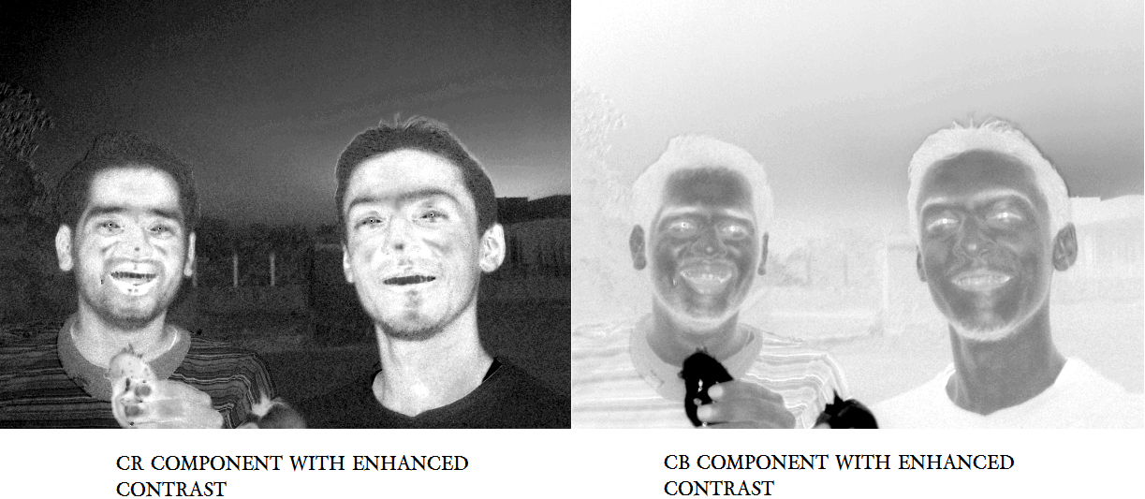

Slide 5
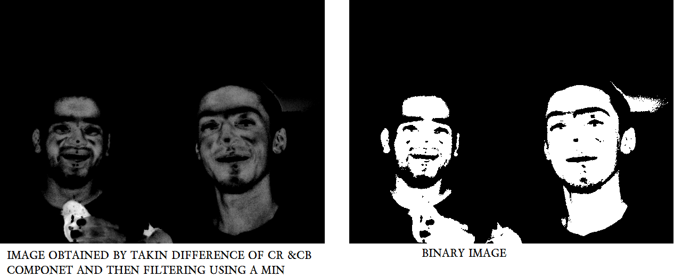

Slide 6
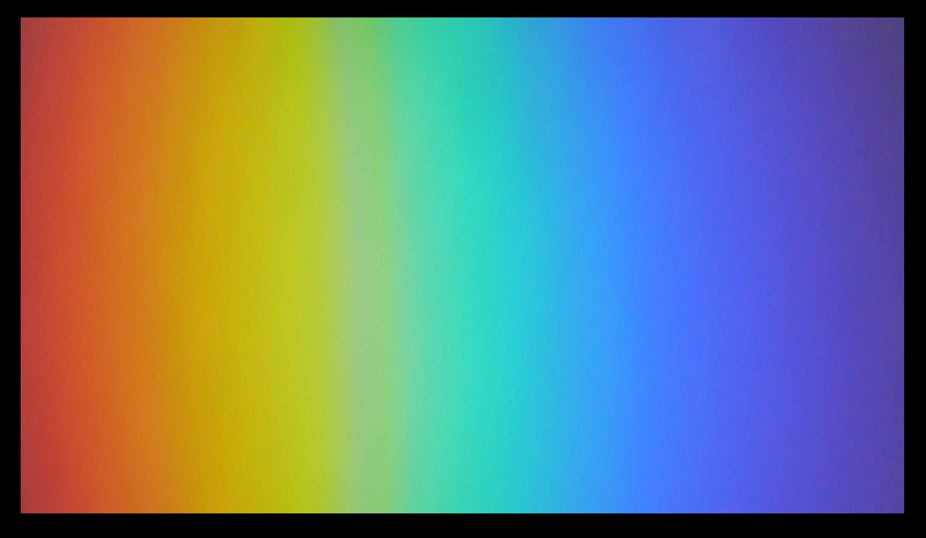


Slide 7
SEGMENTATION OF HAND FROM IMAGE USING SIMILLAR TECHNIQUE

Slide 8
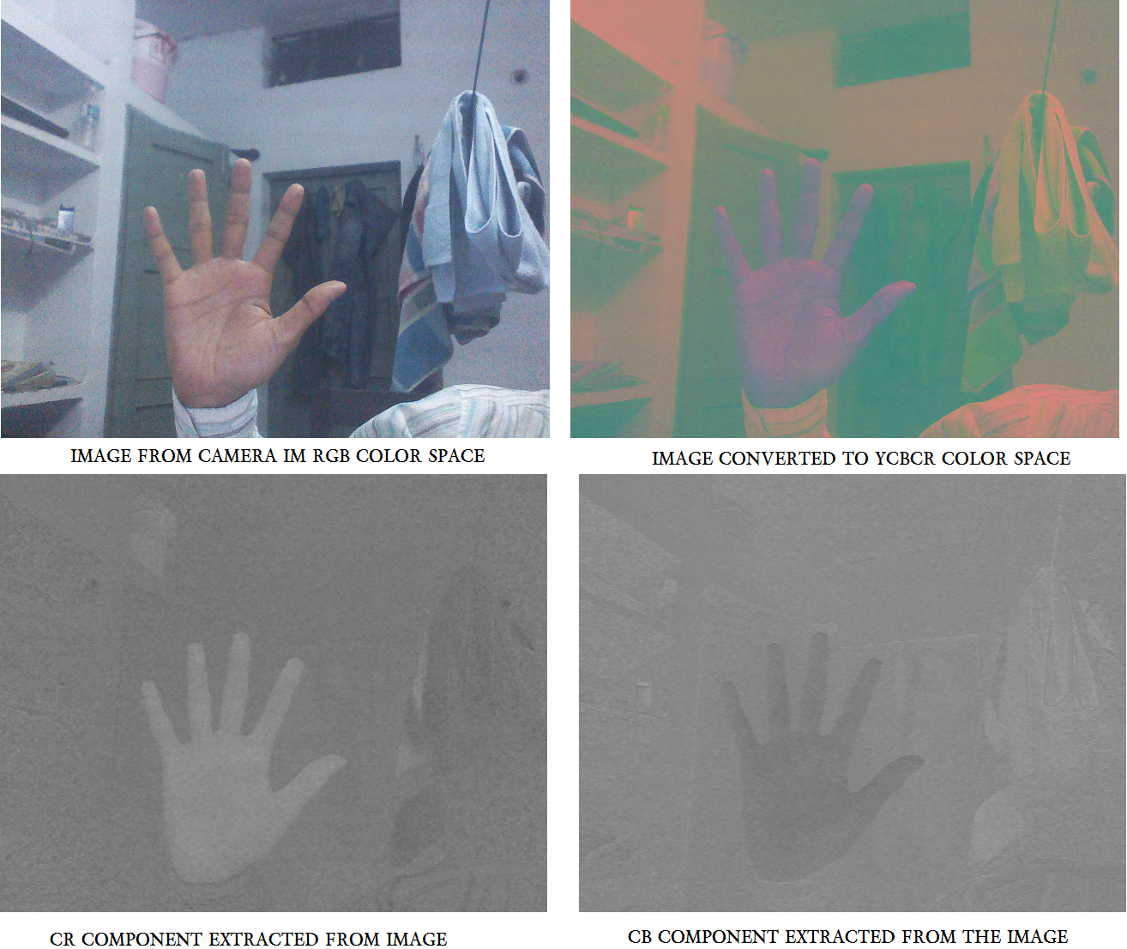

Slide 9
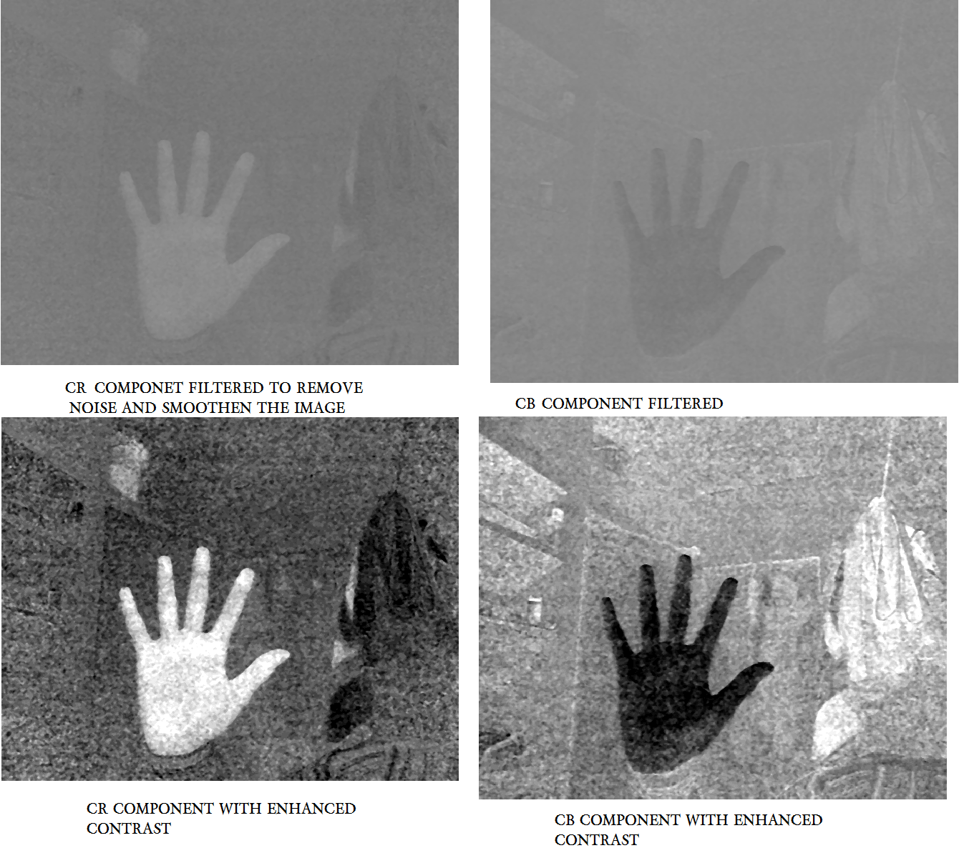

Slide 10
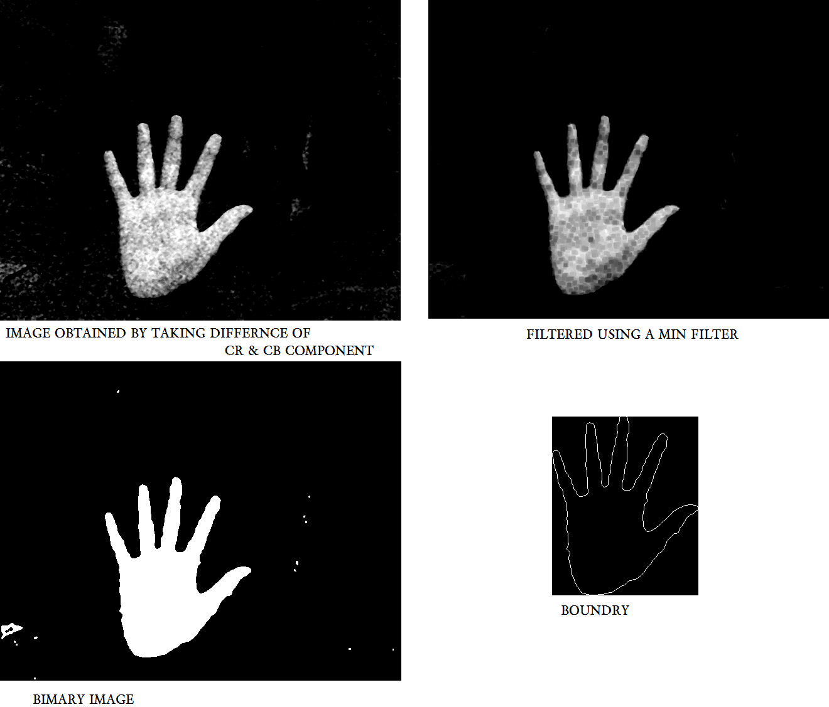

Slide 11
NOW THE COORDINATES OF THE HAND BOUNDRY ARE EXPRESSED AS COMPLEX NUMBER AND DFT IS TAKEN. INVERSE DFT IS TAKEN WITH LESSER NUMBER OF DFT COOEFICIENTS,THIS GIVES A CHARACTERISTIC BOUNDRY FOR THE HAND WITH LESS DISTORTION.

Slide 12
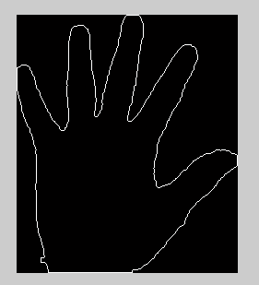
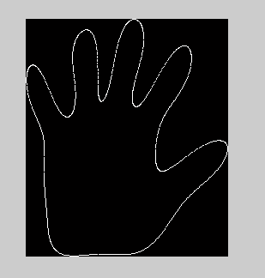

Slide 13
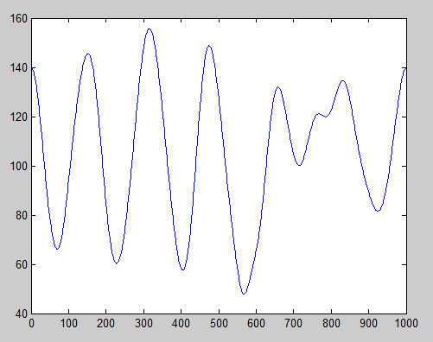
NOW THE SIGNATURE IS PLOTTED BY TAKING DISTANCE FROM THE CENTROID.

Slide 14
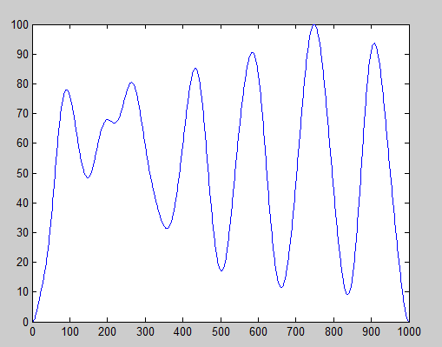
THE PLOTTED SIGNATURE IS MODIFIED SO THAT IS BECOMES INVARIANT TO ROTATION,SCALING AND STARTING POINT

Slide 15
SINCE THE RECOGNITION IS INVARIENT TO ROTATION ,ALL GESTURES AT DIFFERERENT ORIENTATION WILL BE IDENTIFIED AS SAME.
IN ORDER TO DISTINGUISH BETWEEN GESTURES HAVING SIGNIFICANT VARIATION BY FINDING OUT THE SMALLEST ELLIPSE ENCLOSEING THE HAND AND THEN MEASURING ITS MAJOR AXIS ORIENTATION.

Slide 16



Slide 17
Separating Hand From Background Having Same Color
An initial frame is taken containing only the background.
When a frame is taken for recognition it compared with initial frame to detect change .
Since the background is static change will be detected only at the place where hand is present.
A change detection mask can be generated using this.
The change detection mask together with the skin detection mask can be used to segment the hand.

Slide 18
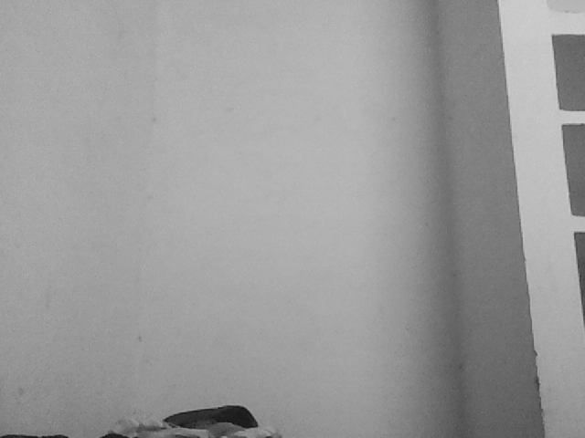
INITIAL FRAME

Slide 19
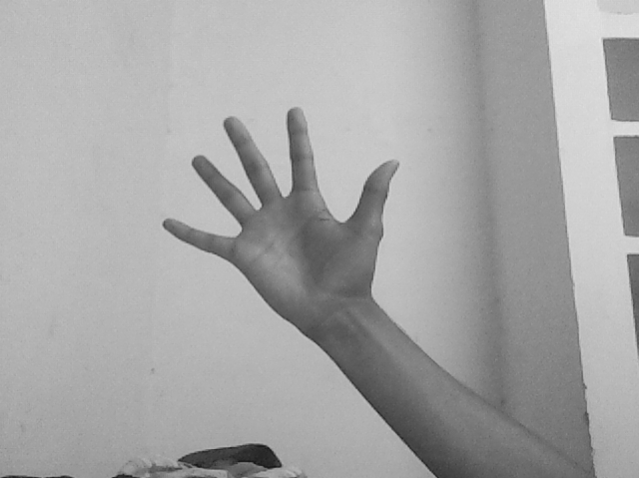
FRAME TO BE USED FOR GESTURE RECOGNITION

Slide 20
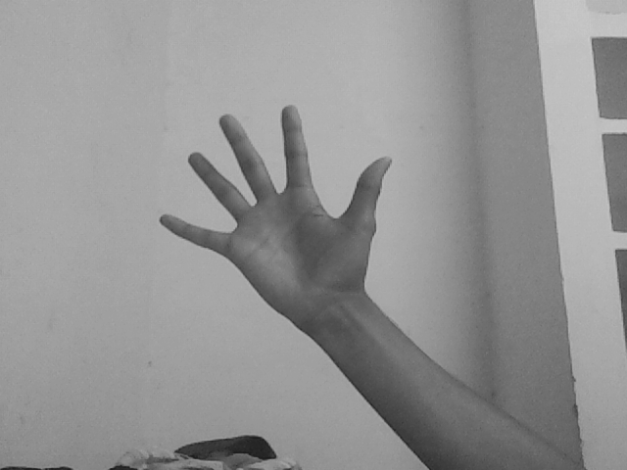
FORMALISED IMAGE

Slide 21
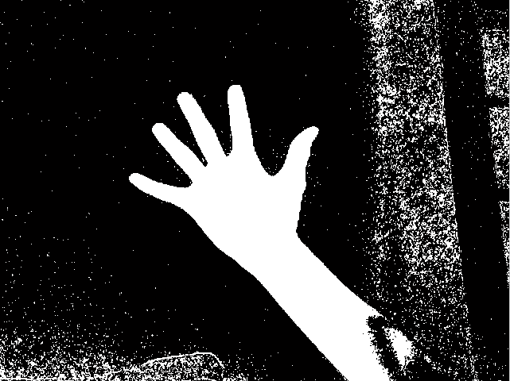
CHANGE DETECTION MASK(CMD)
THE CDM CAN NOW BE SUPERIMPOSED ON THE SKIN DETECTION MASK TO SEGMENT HAND

Slide 23
LIMITATIONS OF CHANGE DETECTION MASK
ONLY WORKS WHEN THE BACKGROUND HAS EVEN TEXTURE.
FOR eg. THE BACKGROUND MAY HAVE WALL BUT NOT OTHER COMPLEX OBJECTS.
THE WALL MAY HAVE MANY COLORS PRESENT ON IT.

Slide 24
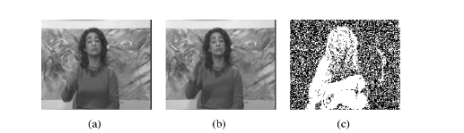
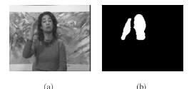

Slide 25
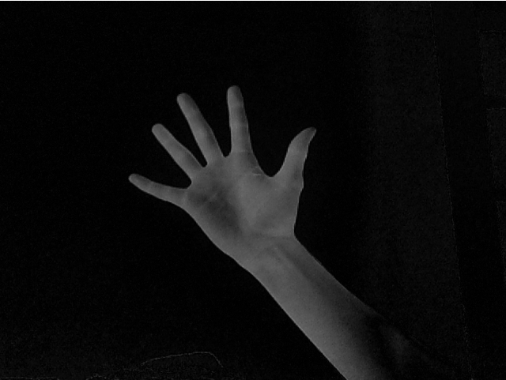
ANOTHER TECHNIQUE TO OBTAIN CMD
A GRAY SCALE IMAGE IS OBTAINED BY SUBTRACTING INTENSITY VALUES OF INITIAL FRAME & THE NORMALISED IMAGE

Slide 26
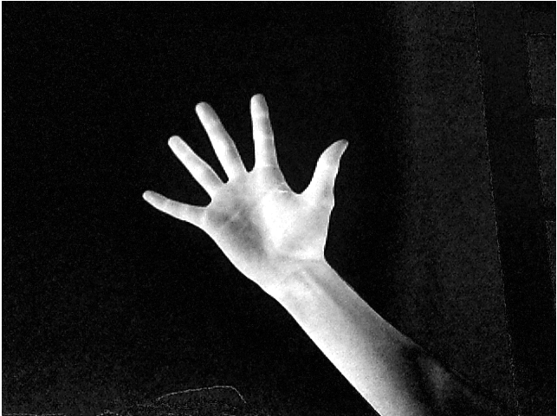
CONTRAST INHANCED

Slide 27
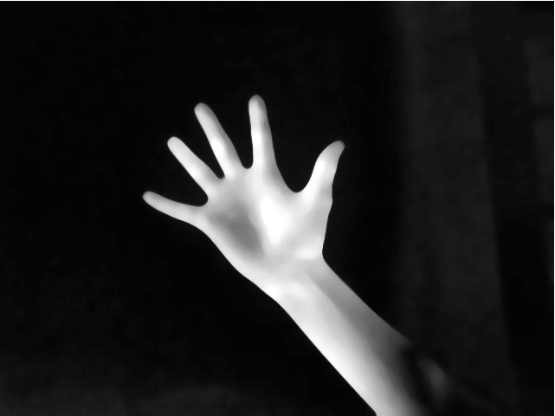
FILTERED IMAGE

Slide 28

BINARY IMAGE

